Slide 1
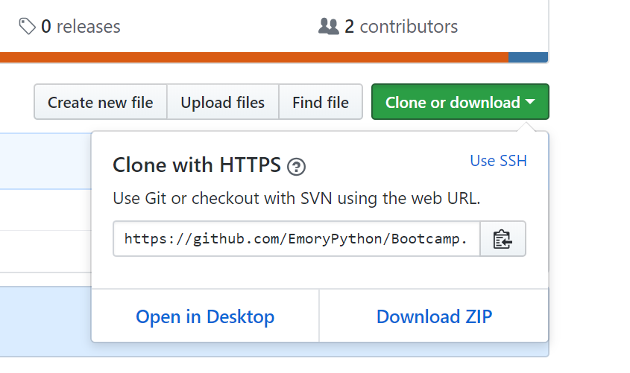
Python Lab – Code Download and Setup
In your browser, open https://github.com/EmoryPython/Bootcamp
Click on the green ‘Clone or Download’ button and ‘Download ZIP’:
Create directory ‘PythonLab’ and extract the downloaded files into this directory
On Git, create your repository if you don’t already have one: https://github.com/

Slide 2
Local and Remote Git Repository Setup
On Windows, open a cmd prompt window, change directories to the folder ‘PythonLab’ you just created
Type git init to create local git repo
Type git remote add origin <your github repo url>
Type git pull origin master
Type git add . to add all files in the current directory to the local repo
Type git commit and enter a commit message
Type git push –u origin master to push your files to your Github remote repo
Any changes to files in this folder can be pushed to the remote repo by repeating steps 5-7

Slide 3
Logistic Regression
Logistic regression is the appropriate regression analysis to conduct when the dependent variable is dichotomous (binary). Like all regression analyses, the logistic regression is a predictive analysis.
We are going to use “sklearn.linear_model.LogisticRegression” in our lab
Objective is to perform Logistic Regression on heart disease data to predict your chance of having a heart disease

Slide 4
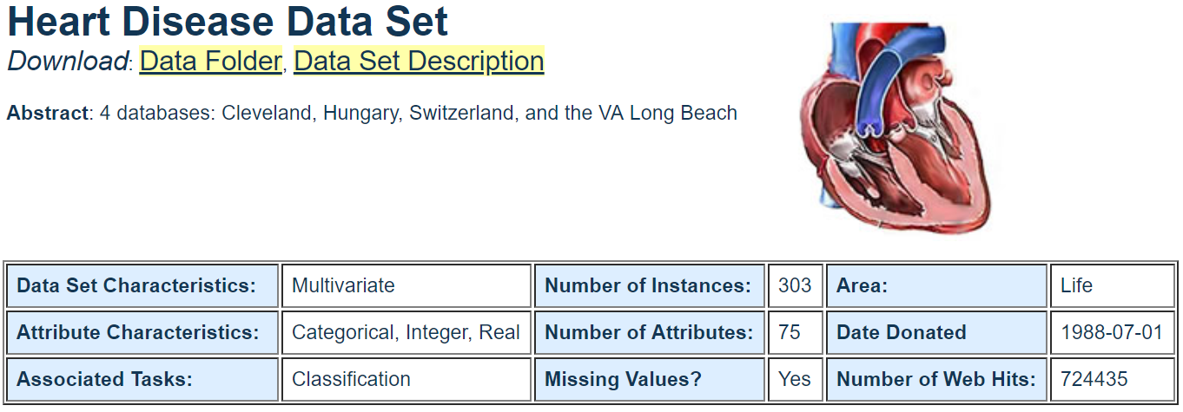
Heart Disease Data Set
This database contains 76 attributes, but all published experiments refer to using a subset of 14 of them. In particular, the Cleveland database is the only one that has been used by ML researchers to this date
Download data from :http://archive.ics.uci.edu/ml/datasets/Heart+Disease

Slide 5
Resources
http://archive.ics.uci.edu/ml/datasets/Heart+Disease
http://scikit-learn.org/stable/modules/generated/sklearn.linear_model.LogisticRegression.html
https://byte7.github.io/projects/heart_disease_analysis/index.html
https://pandas.pydata.org/pandas-docs/stable/tutorials.html

